Slide 1

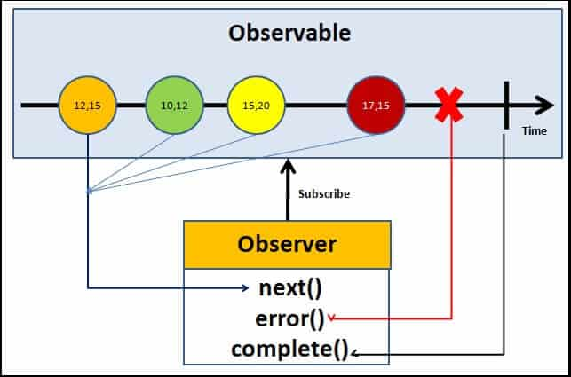

RxJs
Reactive Programming
Stream
Ansynchronous
Reactive programming is programming with asynchronous data streams

Slide 2
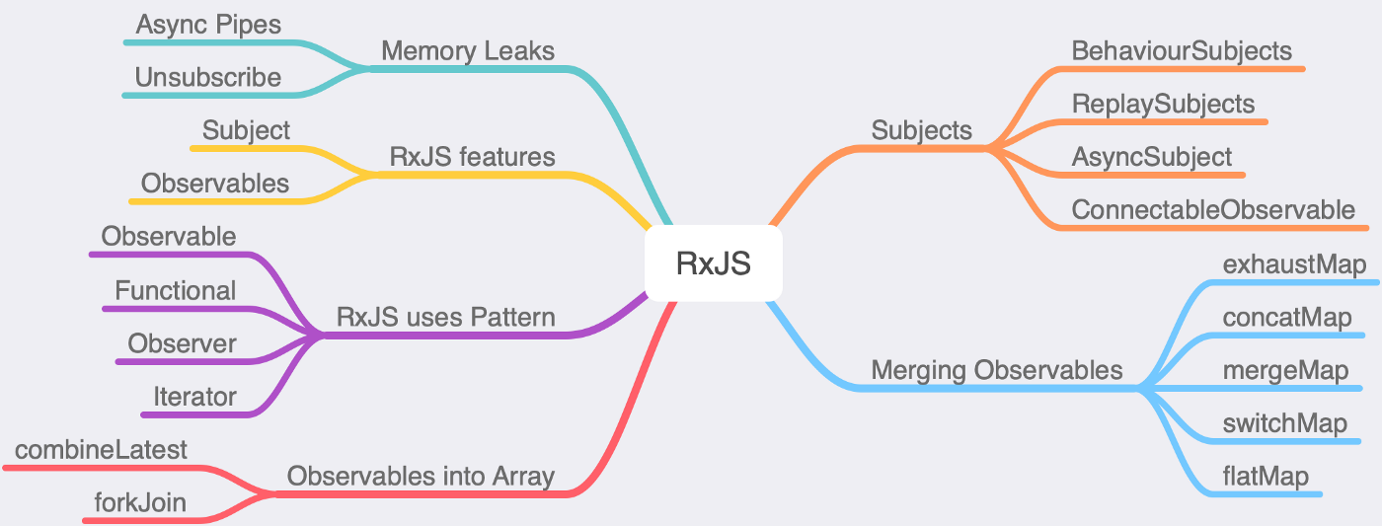
RxJs
Reactive Programming

Slide 3
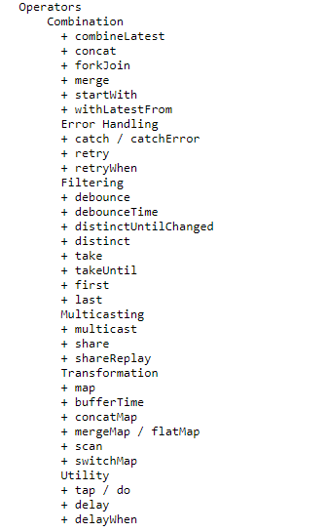
RxJs
Reactive Programming
Subject
AsyncSubject
BehaviorSubject
ReplaySubject
Subjects
Combination
Filtering
Error Handling
Multicasting
Utility
Transformation
Cratetion
Operators

Slide 4
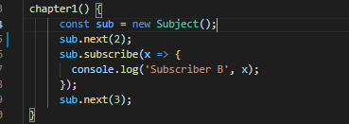

RxJs
Reactive Programming
Subjects
Subject
AsyncSubject
BehaviorSubject
ReplaySubject

Slide 5
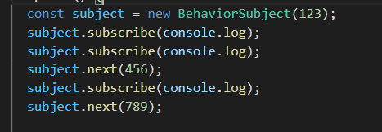
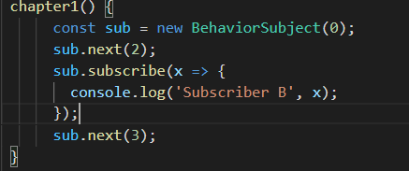
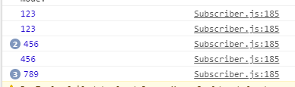

RxJs
Reactive Programming
Subjects
Subject
AsyncSubject
BehaviorSubject
ReplaySubject

Slide 6
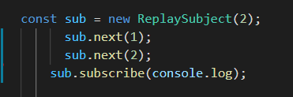
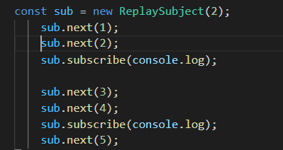

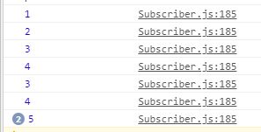
RxJs
Reactive Programming
Subjects
Subject
AsyncSubject
BehaviorSubject
ReplaySubject

Slide 7
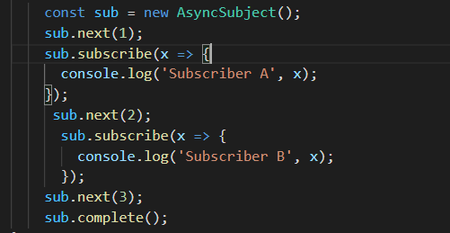
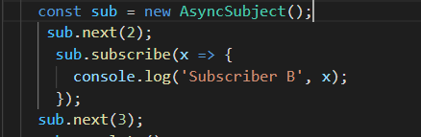
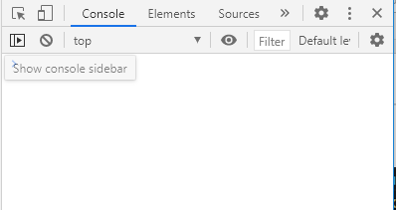

RxJs
Reactive Programming
Subjects
Subject
AsyncSubject
BehaviorSubject
ReplaySubject

Slide 8
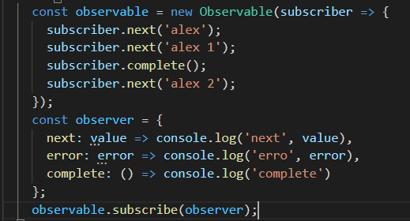
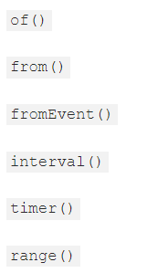

RxJs
Create Observable

Slide 9
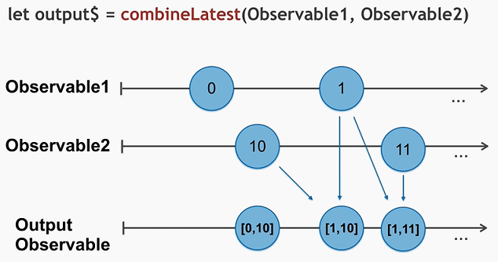
RxJs
CombineLatest vs forkJoin

Slide 10
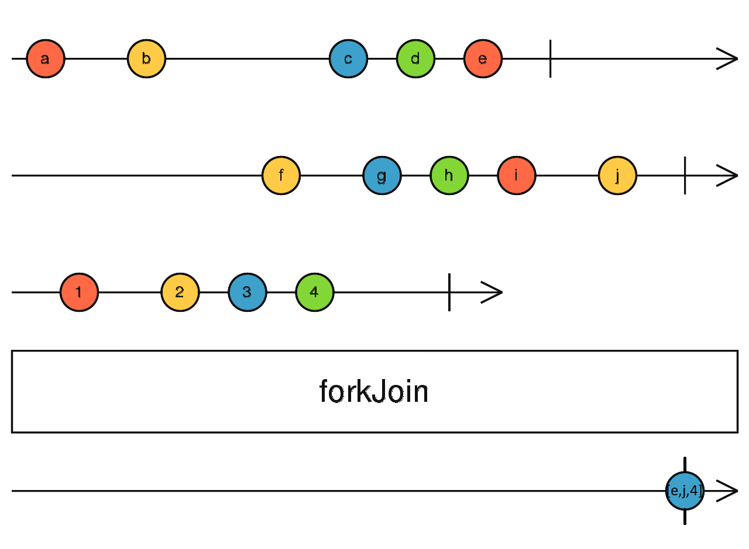
RxJs
CombineLatest vs forkJoin

Slide 11
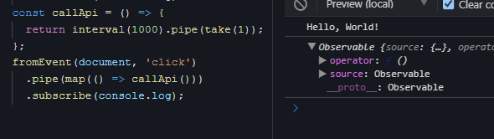
RxJs
Higher Order Observables (HOO)
Merging Observables
SwitchMap
MergeMap
ConcatMap
ExhaustMap

Slide 12
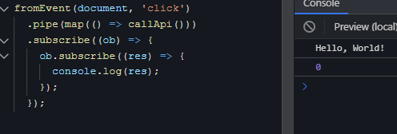
RxJs
Higher Order Observables (HOO)
Merging Observables
SwitchMap
MergeMap
ConcatMap
ExhaustMap

Slide 13
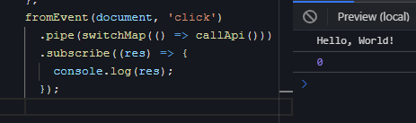
RxJs
Higher Order Observables (HOO)
Merging Observables
SwitchMap
MergeMap
ConcatMap
ExhaustMap

Slide 14
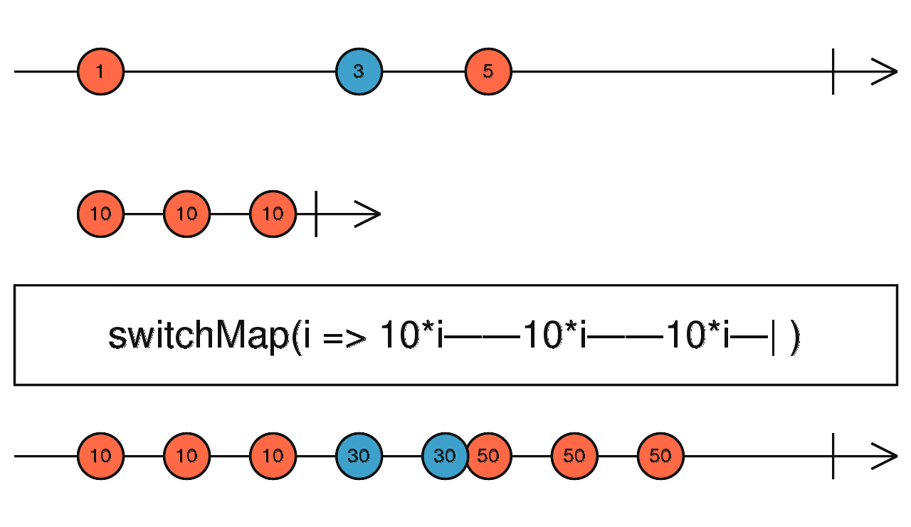
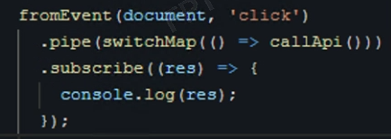
RxJs
Higher Order Observables (HOO)
Merging Observables
SwitchMap
MergeMap
ConcatMap
ExhaustMap

Slide 15
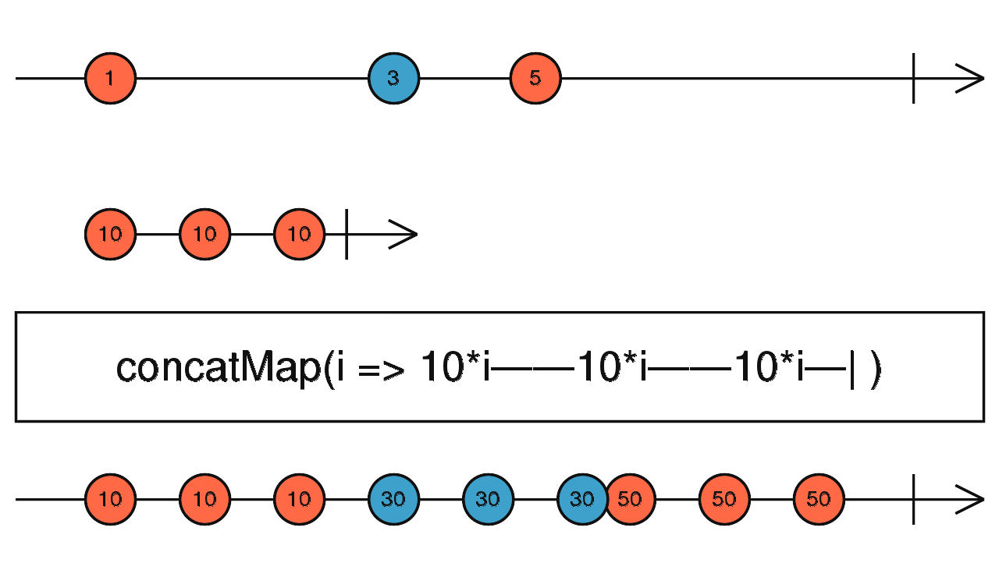
RxJs
Higher Order Observables (HOO)
Merging Observables
SwitchMap
MergeMap
ConcatMap
ExhaustMap

Slide 16
RxJs
Higher Order Observables (HOO)
Merging Observables
SwitchMap
MergeMap
ConcatMap
ExhaustMap

Slide 17
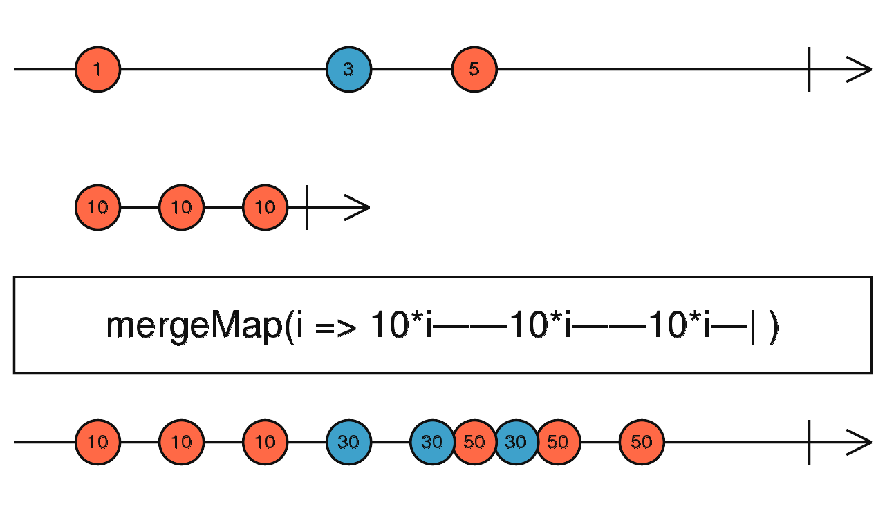
RxJs
Higher Order Observables (HOO)
Merging Observables
SwitchMap
MergeMap
ConcatMap
ExhaustMap

Slide 18
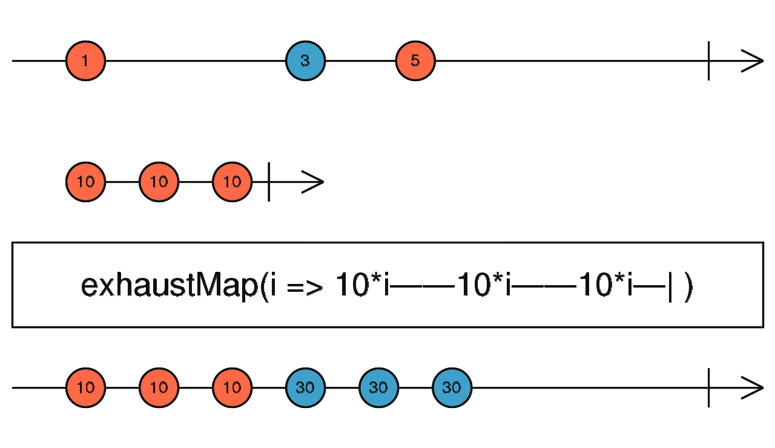
RxJs
Higher Order Observables (HOO)
Merging Observables
SwitchMap
MergeMap
ConcatMap
ExhaustMap

Slide 19
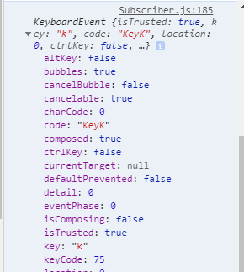

RxJs
Map vs pluck

Slide 20
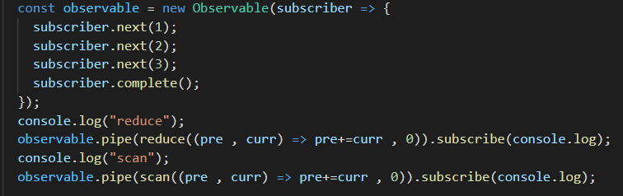
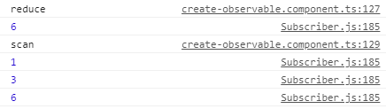
RxJs
Reduce vs Scan

Slide 21

RxJs
Take vs first

Slide 22
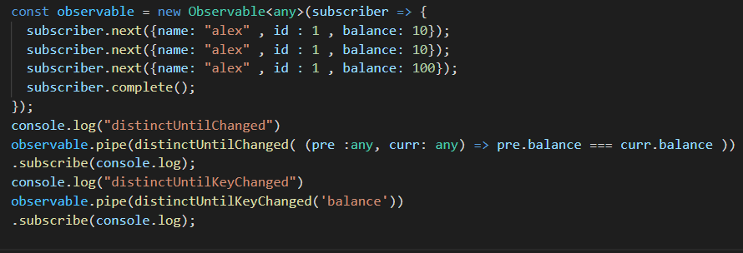
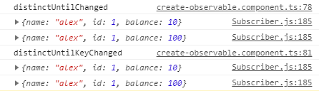
RxJs
distinctUntillKeyChange vs distinctUntillChange

Slide 23
RxJs
distinctUntillKeyChange vs distinctUntillChange

Slide 24
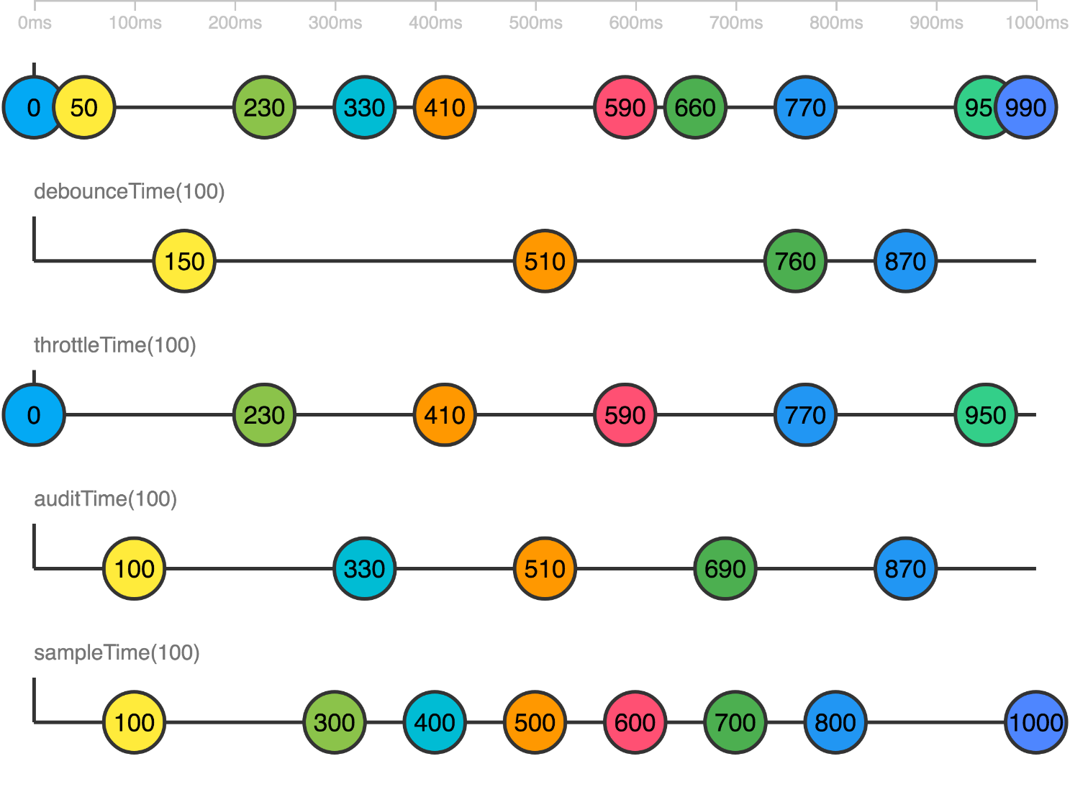
RxJs
debounceTime vs throttleTime vs auditTime vs sampleTime
http://localhost:4200/chapter-1

Slide 25
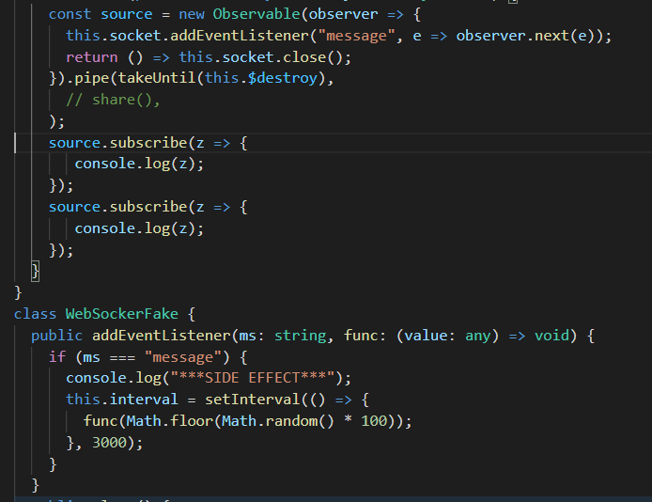
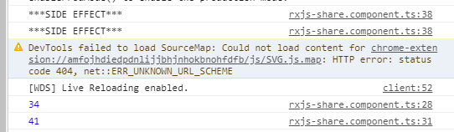
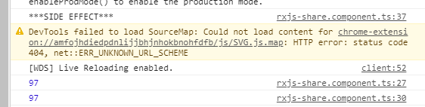
RxJs
Share vs ShareReplace
http://localhost:4200/share

Slide 26
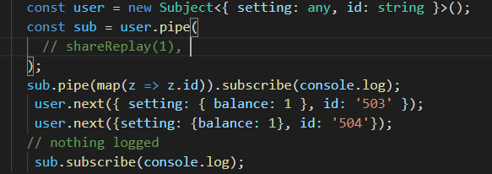


RxJs
Share vs ShareReplace
http://localhost:4200/share

Slide 27
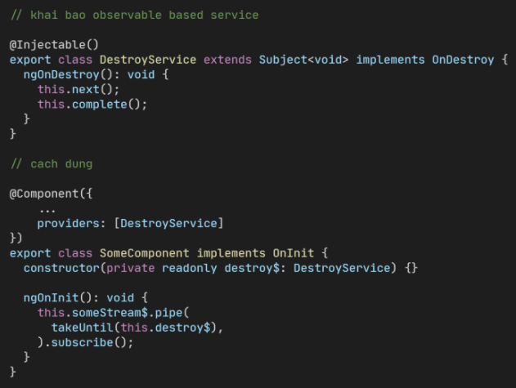
RxJs
Reactive Programming
Operators

Slide 28
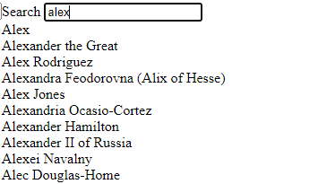
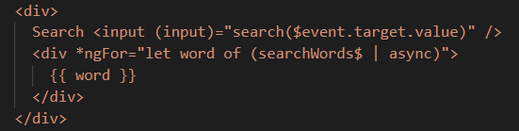
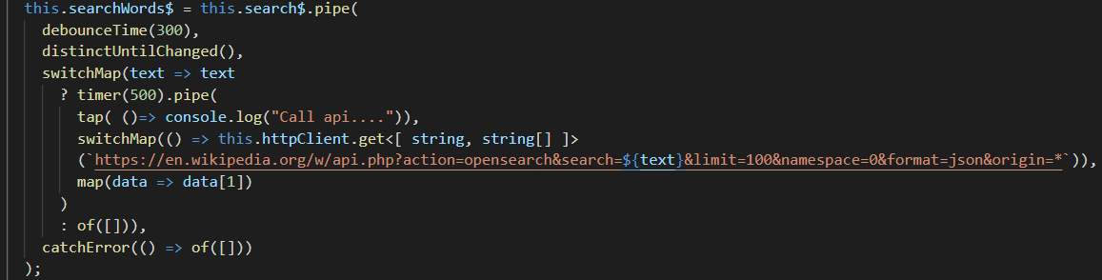
RxJs
Reactive Programming

Slide 29
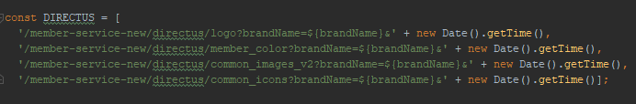
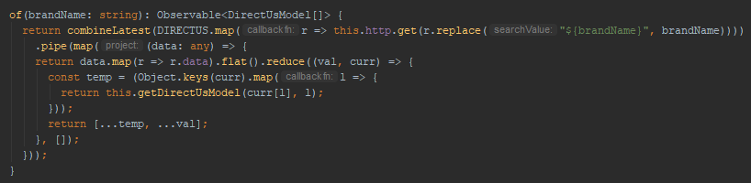
RxJs
Reactive Programming

Slide 30
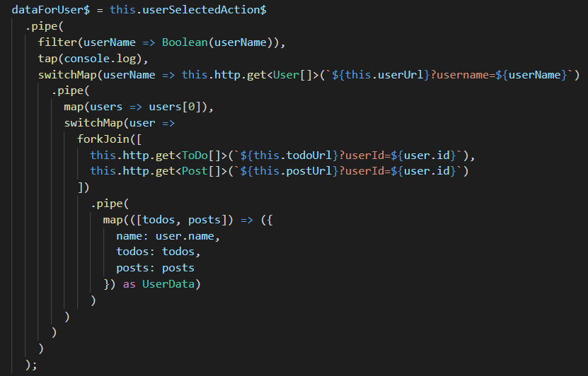
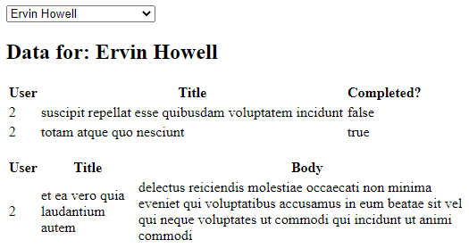

RxJs
Reactive Programming

Slide 31
DEMO

Slide 32
Q & A

